Slide 1
CCF501 Cloud Computing Fundamentals

Slide 2
Subject Descriptor
This subject provides a fundamental understanding of cloud computing.
Students will explore how cloud computing infrastructure has evolved from traditional IT infrastructure and the business advantages this brings.
Additionally, the different cloud segments and cloud deployment models and the key players in the market will be covered.
The subject also provides knowledge of cloud services and cloud security.

Slide 3
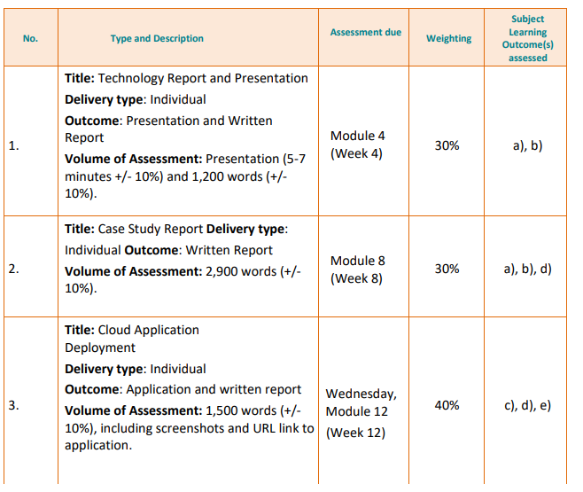

Slide 4
Computing
Computing—computation, storage, communication—is relatively free, scales up or down as needed, scales as much as needed, operates itself, and always works.
For most of computing history the costs of infrastructure have dominated decisions about what to deploy when: How much will those servers cost? How about that storage farm? That network.
Now, however, we can start thinking about those costs being “within epsilon of zero”; that is, over time the computing infrastructure comes closer and closer to being free. That leaves other costs as the new, more significant considerations
Notes:
A storage farm (also called a data farm or server farm) is a large collection of storage servers used to store, manage, and process massive amounts of data. These farms are typically maintained by cloud service providers like Google, Amazon (AWS), and Microsoft (Azure) to offer cloud storage services to businesses and individuals. Real-World Examples of Storage Farms:
Google Drive, Dropbox, OneDrive → Store user files in cloud-based storage farms.
Netflix, YouTube, Spotify → Use massive data farms to store and stream videos and music.
The phrase "within epsilon of zero" is a mathematical way of saying "very close to zero" but not exactly zero.
What Does It Mean in Computing?
The cost of computing infrastructure (hardware, storage, computation, networking) is becoming so cheap that it is almost negligible—but not entirely free.
Example:
Think of cloud storage. Years ago, storing large amounts of data required expensive physical servers. Now, companies like Google and AWS offer gigabytes of free storage and charge very little for extra space. While the cost isn’t exactly zero, it’s so small that many businesses barely notice it compared to traditional IT expenses.

Slide 5
Three Ages of Computing
First Age
At the beginning of the first age the focus was on big infrastructure—mainframes, big point-to-point networks, centralized databases, and big batch jobs.
Toward the end, terminals evolved into personal computers, networks went from hierarchical (with the mainframes at the center of each network) to decentralized, with a broader, generally more numerous collection of servers and storage scattered throughout an organization.
While batch work still existed, many programs became interactive through this first age, eventually gaining much more visual interfaces along the way.
Notes:
"The First Age of computing began with a focus on large infrastructure like mainframes, centralized databases, and batch processing"
In the early days of computing, businesses and organizations relied on mainframes—large, powerful computers that handled all processing.
Data was stored in centralized databases, meaning all information was kept in one place rather than distributed across multiple systems.
Batch processing was common, where computers executed tasks in bulk rather than interactively responding to users in real-time.
"Later transitioning to decentralized networks with personal computers"
Over time, computing shifted from a centralized model (where one mainframe controlled multiple terminals) to a decentralized model (where multiple smaller computers, like personal computers (PCs), handled processing independently).
This meant users had more control over their own machines rather than relying on a central mainframe.
"Interactive programs, and more visual interfaces"
Initially, most computing was done through text-based batch jobs—users submitted tasks, and the computer processed them in bulk.
Eventually, computers began supporting interactive programs, meaning users could input commands and get immediate responses.
This led to the development of graphical user interfaces (GUIs), making computers more user-friendly with icons, windows, and visual elements instead of just text-based commands.
So, the First Age of computing was a transition from centralized, batch-based computing to more decentralized, interactive, and visually rich computing environments.

Slide 6
Three Ages of Computing
Second Age
The second age of computing is really the story of the rise of the Internet—Sun, Cisco, Mosaic (which became Netscape), web 1.0, eBay, Yahoo, , and the first Internet Bubble.
While many advances contributed to the beginning of the second age, the two most crucial were the development of the Internet itself, and the development and near-ubiquity of easy-to-use, visually attractive devices that could be used by nearly everyone.
It is hard to overestimate the importance of two fundamental realities: (1) with the Internet it was now true that everyone was connected to everyone else, anytime, anywhere; and (2) with the ubiquity of visually attractive devices, the data and services available over that pervasive network could actually be used by mere mortals.

Slide 7
Three Ages of Computing
Second Age
1970s and 1980s—most computing was done on relatively mundane, large-scale individual computers, or perhaps in small clusters of relatively big machines.
Whereas an early (circa 1994) Yahoo index might have had less than a hundred, or at most a few hundred entries, and could be manually created, by the beginning of 1995 the number of web sites was doubling every 53 days and was passing anyone’s ability to manually index. This growth then created the need for computing infrastructures that could scale at the same rates or faster, as well as application and data storage architectures that could also scale apace.
Of course one drive that remains true in every age and in every domain is the drive to reduce costs—cost to acquire, cost to deploy, cost to operate, cost here, cost there, cost anywhere—just reduce them all.
Notes:
The second age of computing, marked by the rise of the Internet and the development of accessible, visually attractive devices, saw the emergence of companies like Sun, Cisco, and Yahoo, the explosion of Web 1.0 and eBay, and the first Internet Bubble, all fueled by the connectivity of the Internet and the demand for scalable computing infrastructures and cost reduction.
The second age of computing refers to the period when the Internet became central to technological progress, particularly from the mid-1990s onward. This era saw the rise of major companies like Sun Microsystems, Cisco, and Yahoo, and key innovations such as Netscape (which evolved from Mosaic), Web 1.0, and eBay. The two main drivers of this age were the development of the Internet itself, which allowed global, always-on connectivity between individuals, and the creation of easy-to-use, visually appealing devices that made it possible for almost anyone to access and use the web.
Before this age, most computing was done on large, individual machines or in small clusters of computers. However, as the web grew, particularly in the mid-1990s when the number of websites was increasing rapidly, there was a need for computing infrastructure that could scale to accommodate the massive and accelerating growth of the web. This prompted the development of systems that could handle huge amounts of data and ensure services ran smoothly.
In addition, the constant drive to reduce costs in technology—from acquisition and deployment to operation—remained a key theme in this age, as companies aimed to make technology more affordable and accessible.

Slide 8
Three Ages of Computing
Third Age
Early in the second age Yahoo had made a name for itself by “indexing the Internet,” which for some time was mostly manually done.
Several other indexing efforts began, including AltaVista, Google, and others, but it was Google that brought everything together.
Others offered public cloud services that made certain unique contributions, including , which Salesforce.com was probably the first public cloud service that was targeted at the enterprise customer and required those customers to store very sensitive data outside of their own facilities.

Slide 9
Three Ages of Computing
Third Age
Several key factors can be easily understood.
First, the collection of data about the current state of the Internet, and the processing of that data had to be as absolutely automated as possible.
In order to save as much money as possible, the infrastructure would be constructed out of commodity components, out of “cheap stuff that breaks.”
Data storage needed to be done in a simple, yet fairly reliable manner to facilitate scaling (the Google File System, or GFS—notice the lack of a traditional database, but more on that later).

Slide 10
Three Ages of Computing
Third Age
Several key factors can be easily understood.
New types of application development architecture(s) would be required, which came to include the so-called map-reduce family (which inspired open source descendants such as Hadoop) among others.
Operations needed to be as automatic and dependable as possible.
Outages in the application were tolerable; after all this was search, and who would miss a few results if an outage occurred?
Notes:
The third age of computing saw the evolution from manual indexing of the Internet by companies like Yahoo to the rise of Google, which automated data collection and processing, while also driving the development of public cloud services like Salesforce, requiring enterprises to store sensitive data externally, and the creation of scalable infrastructure using commodity components, new application development architectures like map-reduce, and automated operations to ensure reliability despite occasional outages.
The third age of computing is defined by significant advancements in how data is processed, stored, and accessed. In the early stages of the second age, Yahoo made a name for itself by manually indexing the Internet, but this process quickly evolved with the rise of more advanced search engines like AltaVista and Google. Google ultimately became the dominant force by automating the indexing process, which made it more efficient and scalable.
Around this time, the concept of the public cloud also emerged, with companies like Salesforce offering cloud services aimed at enterprise customers, requiring them to store sensitive data outside their own facilities. To support this massive scale, new infrastructure models were developed that focused on using inexpensive, commodity components, often referred to as “cheap stuff that breaks,” which helped reduce costs.
Another important innovation was the creation of new data storage systems like the Google File System (GFS), which didn’t rely on traditional databases but instead used a more reliable and scalable method. Additionally, the emergence of new application development frameworks, such as the map-reduce model (which later inspired Hadoop), allowed for large-scale data processing.
With these innovations, operations became highly automated to reduce human intervention and ensure systems could handle large-scale data efficiently, even if some downtime occurred. In the context of search engines, a brief outage might not be critical because users could still get most of the search results they needed.

Slide 11
Broad Enablers
Over the course of the 1980s and 1990s there were key advances that came together to enable the transition to the cloud computing, these are some of the more notable enablers:
Commodity Hardware. etc.): In the three basic areas of computing components—chips (processors, memory, etc.), storage (mostly disc drives), and network (both within a datacenter, wide area, and wireless)—there have been large strides made in the capabilities of what is by historical standards throw-away equipment.
Network Speed. While network performance has not increased at the same rate as either processor or storage performance huge strides have been made in both the connections within a datacenter and those outside.

Slide 12
Broad Enablers
Virtualization: Virtualization started as a way to share the use of very expensive mainframes among otherwise incompatible operating systems.
Application Architectures: Software architectures have made many strides toward the eternal goal of software reusability, itself driven by the desire to make it easier to construct software.
Pervasive High Quality Access: The reality—quality, variety, quantity—of high quality, visually attractive, widely available devices has had a tremendous impact on the development of cloud computing. high quality, pervasive, always-connected devices has greatly increased the number of customers for services and content—the data and applications sold on the cloud—and has also increased each customer’s appetite for even more services and data.

Slide 13
BUILDING ROI FROM CLOUD COMPUTING
By examining the benefits that cloud computing offers organisations and by showing the potential return it can provide from the beginning, companies may find it easier to gain buy-in for cloud initiatives from the executive team, as well as from the IT department.
But how do organisations go beyond the initial capacity and utilisation benefits described in cloud computing? In particular it is orientated around two areas:
IT capacity – As measured by storage, CPU cycles, network bandwidth or workload memory, capacity is an indicator of performance.
IT utilisation – As measured by uptime availability and volume of usage, utilisation is an indicator of activity and usability.

Slide 14
BUILDING ROI FROM CLOUD COMPUTING
IT capacity refers to the amount of IT resources available, defined by units of that resource which may be a physical capacity or virtual capacity. This typically includes storage volume, compute power (gigahertz), memory size, database size, number of disk input/output operations, network bandwidth, type of chip set and operating system.
IT utilisation refers to the level of planned and actual use of IT resources that may be physical or virtual. This is different to availability, which is the level of planned or actual uptime an IT resource capacity is available for use. Utilisation refers to the level of use of the IT resource capacity during the uptime period.
Notes:
Key advances in the 1980s and 1990s, such as improvements in commodity hardware, network speed, virtualization, application architectures, and the widespread availability of high-quality, always-connected devices, collectively enabled the transition to cloud computing, enhancing both IT capacity and utilization for organizations seeking scalable, efficient solutions.
The transition to cloud computing was made possible by several technological advancements in the 1980s and 1990s. These included improvements in the hardware used in computing (such as processors, memory, and storage), faster networks (both within data centers and for remote connections), and the rise of virtualization, which allowed more efficient use of expensive mainframes. Additionally, software architecture improvements made it easier to reuse code and build applications, while the availability of high-quality, widely accessible devices with constant internet connectivity expanded the potential customer base for cloud services.
These advances allowed businesses to manage and scale their IT resources—like storage, processing power, and network bandwidth—more effectively. IT capacity refers to the total amount of these resources available, while IT utilization focuses on how much of that capacity is actually being used during the time it’s available. Together, these developments helped businesses optimize both the performance and efficiency of their IT systems through cloud computing.

Slide 15
BUILDING ROI FROM CLOUD COMPUTING
Eight business metrics that translate the indicators of the capacity–utilisation curve to direct and indirect benefits to the business.
Speed and rate of change – The speed and rate of change of cost reduction can be much faster using cloud computing than traditional investment and divestment of IT assets because the responsibility is transferred to the service provider. While there are challenges today in the portability of cloud service providers, users do have greater flexibility to adopt and remove the service either at the point of use (to scale up and down) or to make choices to use new services or change service provider.
Optimising total cost of ownership (TCO) – A key aspect of moving to cloud computing is the ability to select hardware, software and services from defined design configurations to run in production. Cloud computing bridges the design time and run-time divide and optimises service performance

Slide 16
BUILDING ROI FROM CLOUD COMPUTING
Rapid provisioning – Elastic provisioning to scale up and down to actual demand creates a new way for enterprises to match their IT to enable business to expand. The provisioning time compression from a week to hours, for example, demonstrated by cloud computing providers is a means to rapid provisioning that is not just about saving time, but is also defining a new business operating model.
Increase margin and cost control – Cloud computing offers the opportunity for cost, revenue and margin advantages. It also allows organisations the potential to enter and exploit new markets through rapid deployment of low-cost cloud services.
Access to business skills and capability improvement – Cloud computing enables access to new skills and solutions through cloud sourcing on-demand systems.

Slide 17
BUILDING ROI FROM CLOUD COMPUTING
Dynamic usage – Elastic computing and service management targets real end users and real business needs for functionality as the scope of users and services evolves seeking new solutions. With either fixed usage volumes or variable functional usage, new innovative consumption models enabled by cloud computing allow businesses to consider using IT in a flexible and agile way.
Risk and compliance improvement – Cloud computing green capabilities can be leveraged through shared services.
Enhanced capacity utilisation – IT avoids over- and under-provisioning of IT services to improve smarter business services.
Notes:
Building ROI from cloud computing" refers to the process of generating a return on investment (ROI) by leveraging cloud computing technologies. This involves using the cloud to reduce costs, improve efficiency, scale operations, and unlock new business opportunities, ultimately leading to greater financial returns. The idea is that by shifting IT resources and services to the cloud, businesses can save on infrastructure costs, improve performance, and increase flexibility, resulting in a positive financial impact over time.
Eight business metrics that translate the capacity-utilization curve into benefits for businesses include speed and rate of change, optimizing total cost of ownership (TCO), rapid provisioning, increased margins and cost control, access to business skills and capability improvement, dynamic usage, risk and compliance improvement, and enhanced capacity utilization, all enabled by cloud computing's flexibility, scalability, and cost-efficiency.
Speed and rate of change: Cloud computing allows for faster cost reduction because businesses can quickly scale services up or down, transferring responsibility for IT management to service providers, even though some challenges in portability still exist.
Optimizing total cost of ownership (TCO): Cloud services let businesses select the right hardware, software, and configurations, streamlining both the design and runtime stages to improve service performance and reduce costs.
Rapid provisioning: Cloud computing enables businesses to scale their IT resources quickly to meet actual demand, cutting down provisioning times from weeks to hours and redefining business operations with faster, more flexible deployment.
Increase margin and cost control: By using cloud services, companies can lower costs and increase margins, while also entering new markets more easily with low-cost cloud offerings.
Access to business skills and capability improvement: Cloud computing provides on-demand access to new skills and solutions through cloud sourcing, improving business capabilities without the need for in-house expertise.
Dynamic usage: Cloud services can be adjusted to meet real business needs, whether usage is fixed or variable, allowing businesses to be more agile and flexible in their IT consumption.
Risk and compliance improvement: Cloud computing enables better risk management and compliance, especially with environmentally sustainable (green) solutions offered through shared services.
Enhanced capacity utilization: Cloud computing ensures that IT services are better matched to actual demand, avoiding over-provisioning or under-provisioning, which improves overall service efficiency and smarter business decisions

Slide 18
FIVE MAIN BENEFITS ATTACHED TO CLOUD SERVICES
Cost efficiency – Shared infrastructure means shared costs. You also pay only for what you use, because most pricing models are consumption-based. This can be ‘per user’, ‘per device’, ‘per server’ or ‘per instance’.
Easy to use – Basic cloud services work ‘out of the box’. For more complex software and database solutions, cloud computing allows you to skip the hardware procurement and capital expenditure phase and just get on with the implementation.
Up to date – Most providers constantly update their software offering, adding new features as they become available.
Scalability – Depending on business growth, you can grow or contract quickly as cloud systems are built to cope with sharp increases and reductions in workload. Pricing models are built to support software reductions should businesses need to scale down, which removes the business pressures associated with fixed costs

Slide 19
FIVE MAIN BENEFITS ATTACHED TO CLOUD SERVICES
Mobile – Cloud services are designed to be used from a distance, so if you have a mobile workforce, staff can access most of your systems ‘on the go’, increasing productivity.
Notes:
The five main benefits of cloud services are cost efficiency through shared infrastructure and consumption-based pricing, ease of use with out-of-the-box services, constant updates to software, scalability to quickly adapt to business growth or contraction, and mobile accessibility for a productive, remote workforce.
Cost efficiency: By using shared infrastructure, businesses can share the costs with other users, meaning they only pay for what they use, which is often based on consumption. This could be charged per user, device, server, or instance, making it more affordable and flexible.
Easy to use: Many cloud services are designed to work straight away, requiring minimal setup. For more complex needs, like databases or software solutions, cloud computing eliminates the need for businesses to buy hardware and go through lengthy capital expenditure processes, allowing them to start implementation immediately.
Up-to-date software: Cloud providers continuously update their software offerings, meaning businesses benefit from the latest features and improvements without having to manually upgrade or maintain systems.
Scalability: Cloud systems are designed to handle sudden changes in demand, so businesses can quickly scale their operations up or down. This flexibility helps companies avoid the financial burden of fixed IT costs when they need to adjust based on business needs.
Mobile accessibility: Cloud services are built for remote access, so employees can work from anywhere. This is particularly beneficial for companies with mobile or distributed workforces, allowing staff to stay productive while on the go.

Slide 20
CLOUD
The core difference between cloud and traditional IT is that in a true cloud model you don’t own the IT: you don’t buy a server and an application licence, but instead the IT gets delivered to you as a service via the internet when you need it.

Slide 21

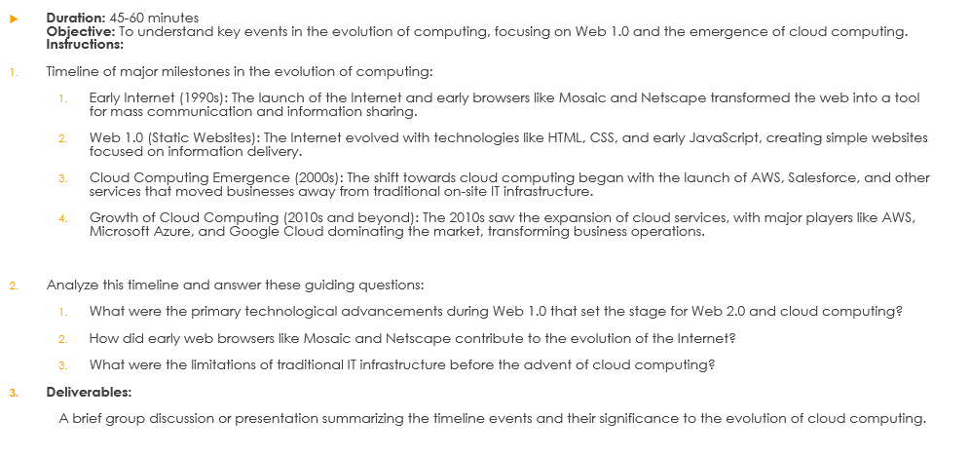
In class activity: Timeline Exploration of Computing Evolution

